Slide 1
Strategy Pattern
Ahmet AYDIN

Slide 2
Strategy Pattern
Also known as Policy
General View:
  Define a family of algorithms
  Encapsulate each one
  Make them interchangeable
Strategy lets the algorithm vary independently from clients that use it
“Don’t tell me the details, just do it.”

Slide 3
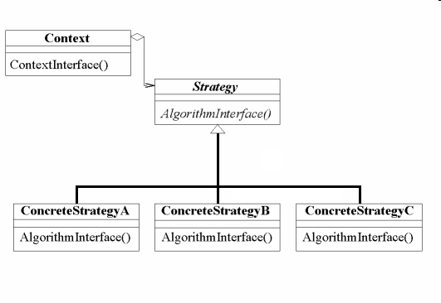
Structure

Slide 4
Participants
Strategy (Compositor)
  declares an interface common to all supported algorithms. Context uses this interface to call the algorithm defined by ConcreteStrategy
ConcreteStrategy (SimpleCompositor)
  implements the algorithm using the Strategy interface
Context (Composition)
  is configured with a ConcreteStrategy object
  maintains a reference to a Strategy object
  may define an interface that lets Strategy access its data

Slide 5
Applicability
Related classes: different behavior, but not different interface
  Configure a class with behavior
Algorithm variants: different time space trade-offs.
Private data: algorithm uses data that clients should not know about
A class with many different behaviors: if you have too many “if”s in your code

Slide 6
How to implement
Implement a Strategy interface for your strategy objects
Implement ConcreteStrategy classes that implement the Strategy interface, as appropriate
In your Context class, maintain a private reference to a Strategy object.
In your Context class, implement public setter and getter methods for the Strategy object

Slide 7
How to implement
The Strategy and Context interfaces must give ConcreteStrategy efficient access to any data it needs from a context, and vice versa.
  Context passes data in parameters to Strategy operations
  context pass itself as an argument
  the strategy can store a reference to its context

Slide 8
Implementation
Encoder-Decoder

Slide 9
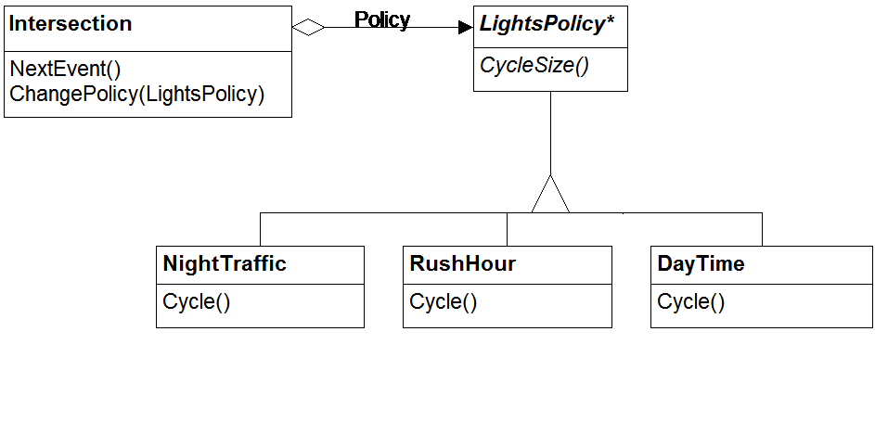
Another Scenario

Slide 10
Advantages
makes your algorithms interchangeable, reusable and hidden from the client.
you can change strategy at runtime
code is easier to modify
eliminates conditional statements

Slide 11
Disadvantages
Clients must be aware of different Strategies
  a client must understand how strategies differ before it can select the appropriate one
Increased number of objects

Slide 12
Known Uses
ET++ uses the Strategy pattern to encapsulate layout algorithms for text viewers
Drawing programs like UniDraw use the Strategy pattern to select different tools. This makes it easy to add new tools
MacApp uses the Strategy pattern to add adornments and event handlers to a window
Borland's ObjectWindows uses strategies to encapsulate validation algorithms for dialog box entry fields
Strategy objects have also been used for sorting algorithms, memory allocation algorithms, graph layout algorithms, and register allocation schemes

Slide 13
References
http://alumni.media.mit.edu/~tpminka/patterns/Strategy.html
http://javalab.cs.uni-bonn.de/research/darwin/strategyPattern.html
Head First - Design Patterns
Java Design Patterns A Tutorial [IDM]

